Slide 1
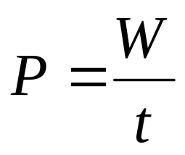
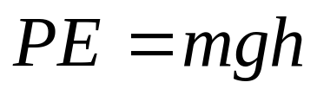
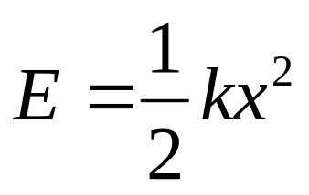
Power and Potential energy
Physics 131
Lecture 11
Average and instantaneous power Watt
Gravitational potential energy
Work done in a uniform gravitational field
Elastic potential energy
kWh is a measure of energy
Conservative and nonconservative forces
All found in Young and Freedman, University Physics, chapter 6, section 4 and chapter 7, sections 1 to 3
Notes:
We’ve looked at work and kinetic energy. Today I want to talk briefly about power and then move onto potential energy.
Here’s a list of what you need to know from this lecture. You have this information on the handout I have given you. The handout also includes the text book references.

Slide 2
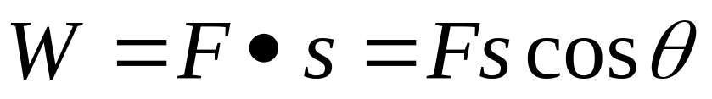
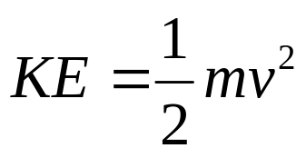
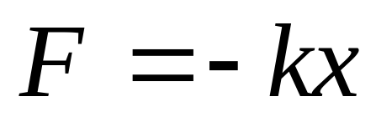
Review
Last lecture we looked at Work and :
Definition of work
Kinetic Energy, specifically
Force constant and Hooke’s law
The work-energy theorem for both constant and varying force
Notes:
Last lecture we looked at Work and Kinetic Energy, specifically:
Definition of work (force times distance in direction of force)
Scalar product of two vectors (F dot s for work)
Work done by a varying force (integral of F dot s when direction and magnitude of F varies)
Force constant and Hooke’s law (F=kx for stretched substance, small stretches, and W = ½ kX² )
The work-energy theorem for both constant and varying force (W=change in ke)
Problem solving strategies

Slide 3
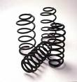
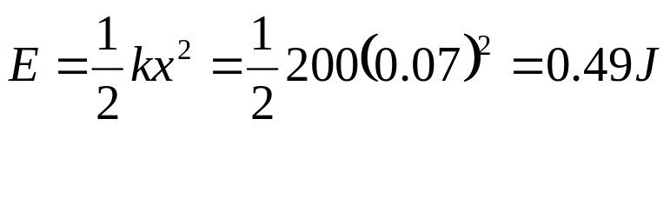
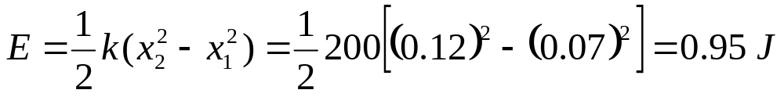
Energy of spring
How much energy is stored in a spring of spring constant k = 200 Nm⁻¹ compressed 7 cm.
If it is compressed a further 5 cm how much extra energy is stored?

Slide 4

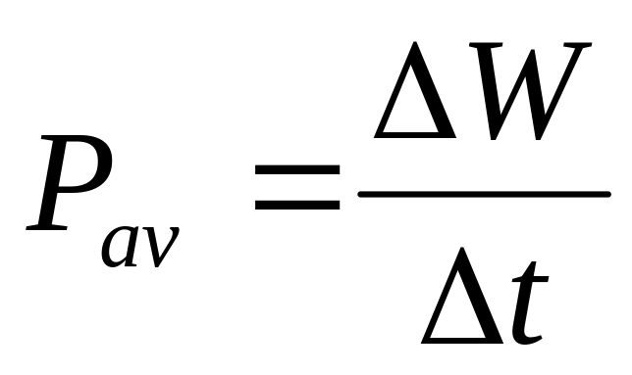
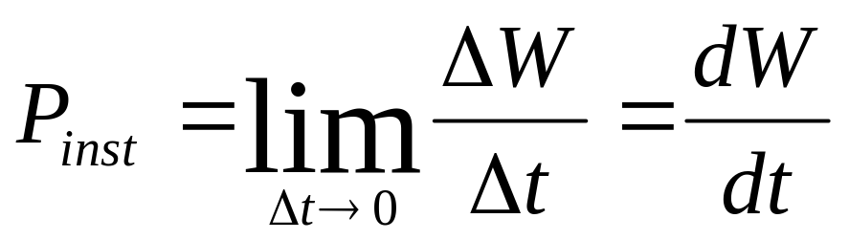
Definition of Power
Power is defined as the time rate at which work is done
Average power is defined as
Instantaneous power is defined as
It’s SI unit is the watt, W
Notes:
Work makes no reference to time…it’s just force times distance essentially. So if you take a year to push the fridge across the kitchen floor you use the same amount of energy, do the same amount of work, as if you pushed it in 5 minutes. You would probably agree that there’s a big difference between taking 1 hour to do a test and one week…see that time can be an important factor to take into account. Sometimes we want to get a handle on how time fits in with work, how fast work is done. For this we use the concept of Power. In physics power is defined as the time rate at which work is done. It is a scalar quantity (so just magnitude).
We can calculate the average power when a quantity of work delta W is done during a time interval delta t. It is defined as shown. This is fine when the rate at which work is done is constant, but when it isn’t (eg when you push the fridge hard for 5 seconds then stop for a breather then push again) we need instantaneous power, the ability to calculate power at a certain instant. It is the limit of average power as delta t goes to zero (just like we did for average and instantaneous velocity etc). We get the equation shown.
The SI unit of power is the watt, W (named after James Watt who did a lot of work on power). You can see that one watt equals one joule per second.

Slide 5
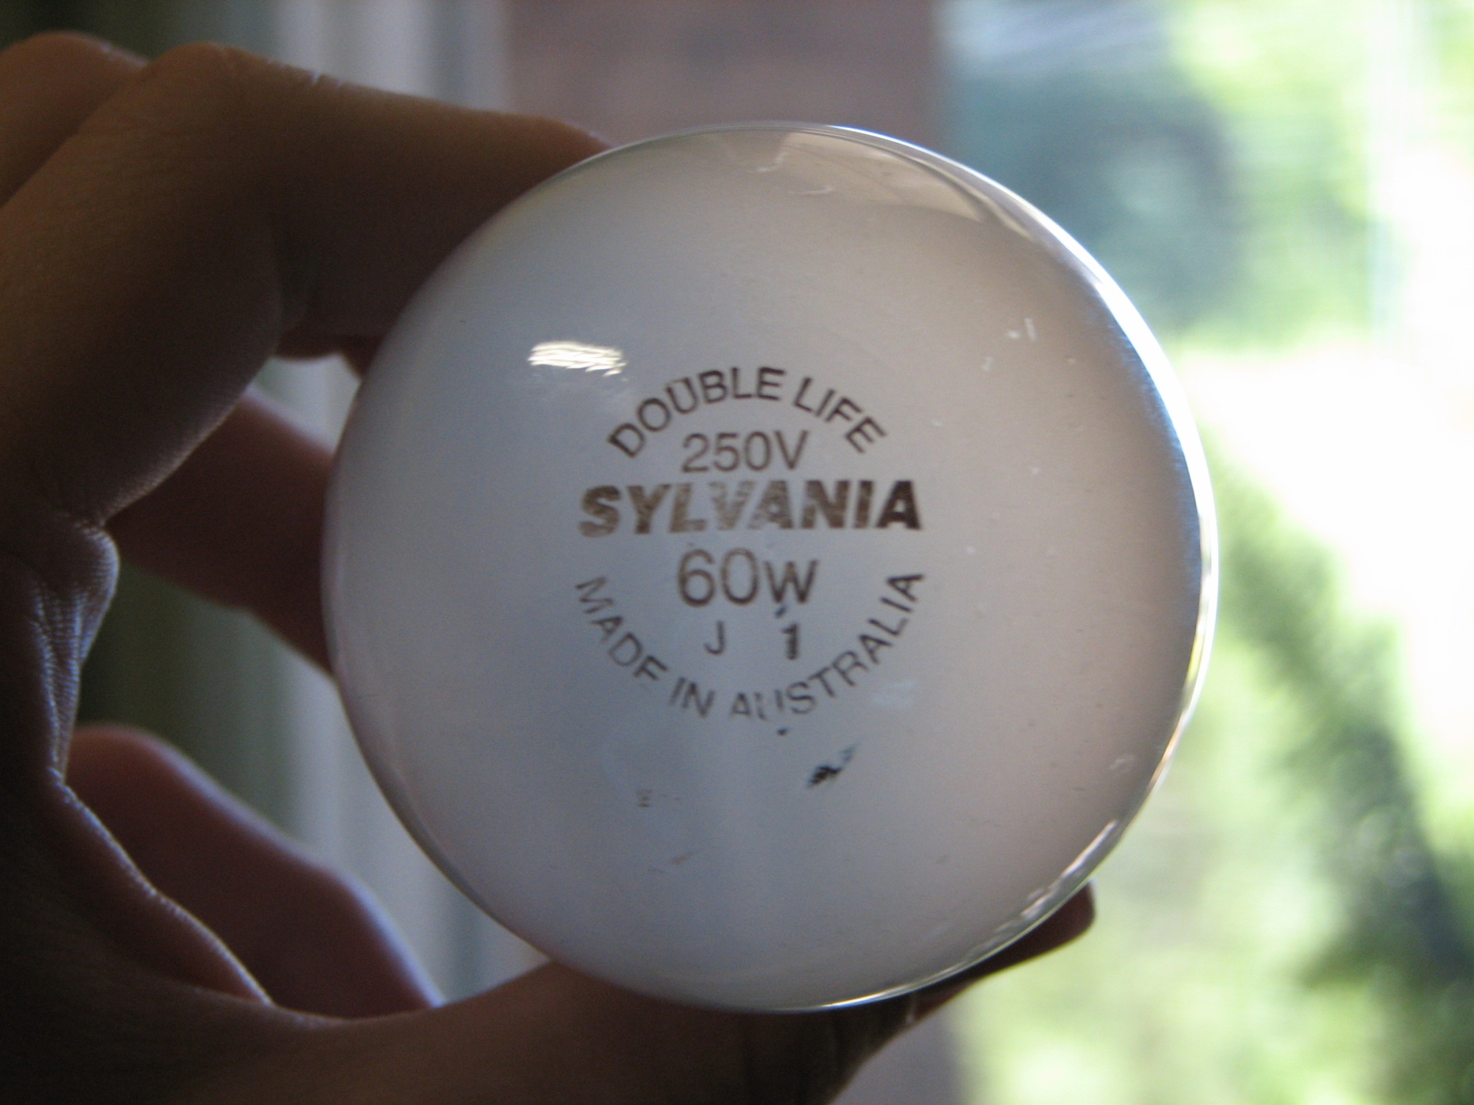
Power is stated on appliances

Slide 6
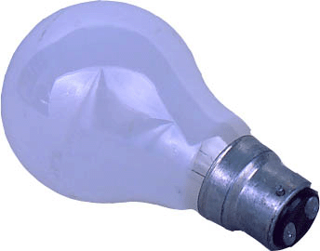
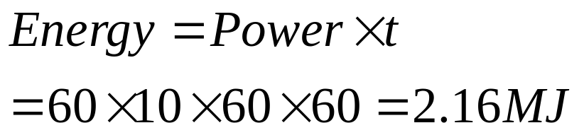
Example: Energy of a light globe
Calculate the energy used by a 60 W light globe if it is left on overnight for 10 hours.

Slide 7
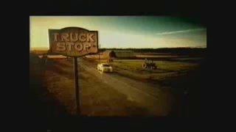

Slide 8
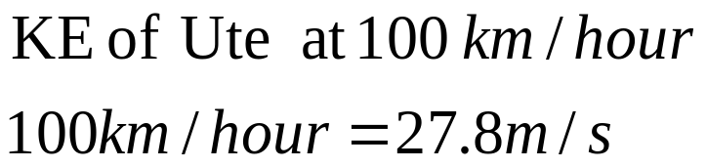
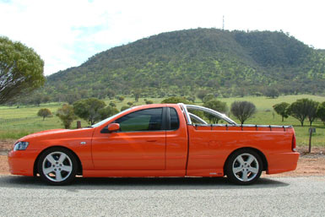
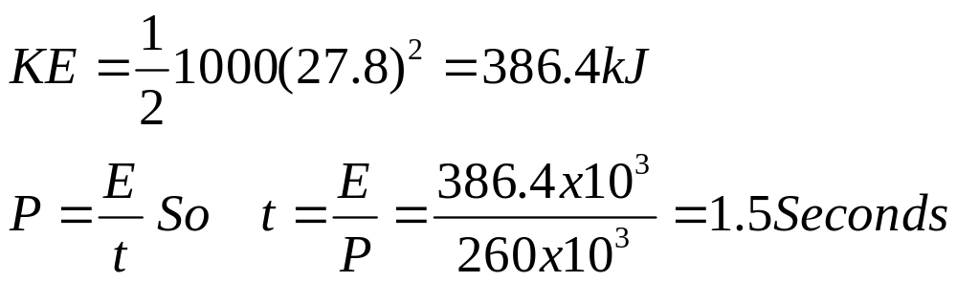
New V8 Ute
A recent add on TV is selling Falcon utes with a “pulling power” of 260 kW.
If the utes weighs 1000 kg, and all the power was put into KE, how long would it take to reach 100 km/hour.
Notes:
An add on TV talks about a use producing

Slide 9
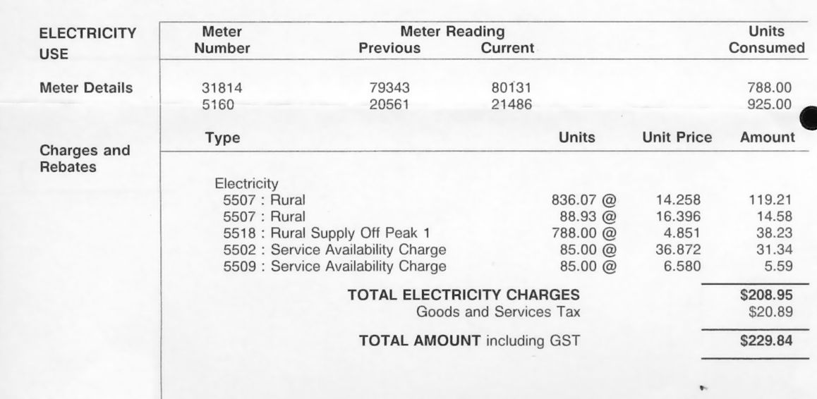
Electrical meters measure kWh
“Units” are kWh

Slide 10
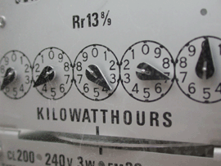
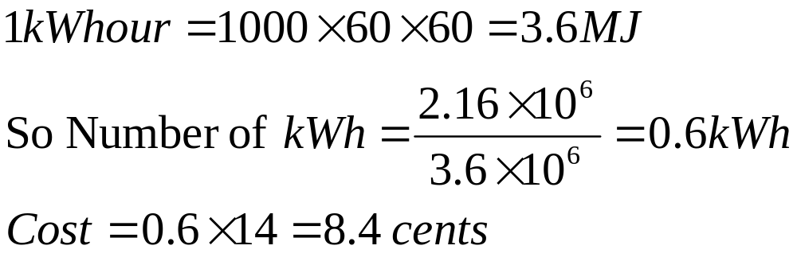
Kilowatt Hours
1 kWh = (10³ J/s)(3600 s) = 3.6 x 10⁶ J = 3.6 MJ
The 60 W light globe that was left on for 10 hours used 2.16 MJ of energy. How much would this cost if electricity cost 14 c /kW hour
Notes:
You will also come across a unit called the kilowatt-hour. It is a unit of work or energy, not power. It is the usual commercial unit of electrical energy. One kilowatt-hour is the total work done in 1 hour when the power is 1 kilowatt. SEE SLIDE – it equals 3.6 MJ.
Another conversion factor used with power is the unit of horsepower, hp. 1 hp = 746 W = 0.746 kW
Another way of finding power is to use the force and velocity….you can see that work = F times distance and power = W/t = F times distance /time and distance /time = velocity. We end up with another equation for power which is Power = Force times velocity. Because we want the velocity to be in the direction of the force we get back to the dot product of F and v.

Slide 11
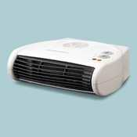
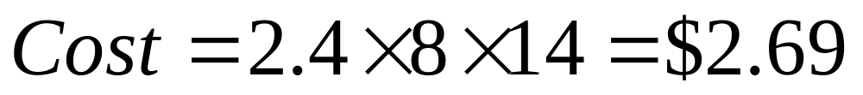
kWh
A air forced 2.4 kW heater is left on during office hours of 9-5. If the electricity costs 14c/kWh how much does the heat cost each day?

Slide 12
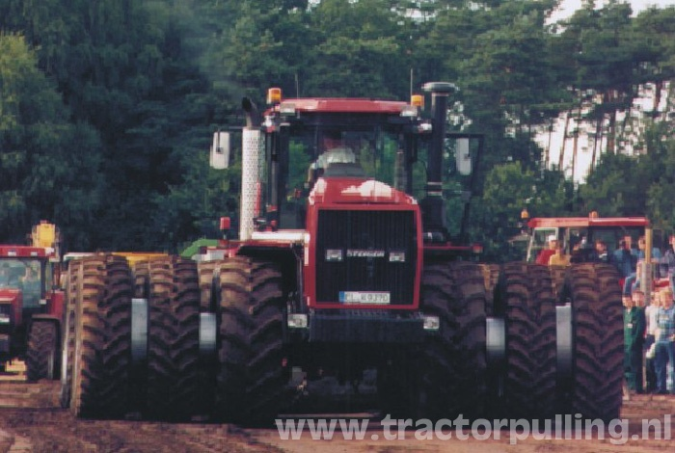
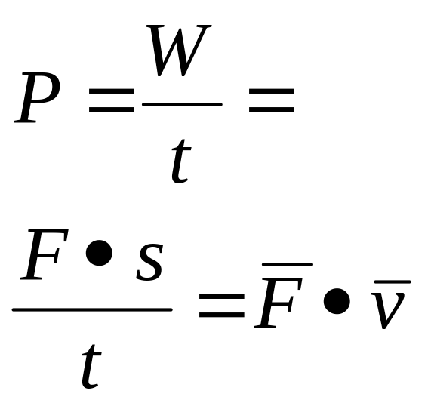
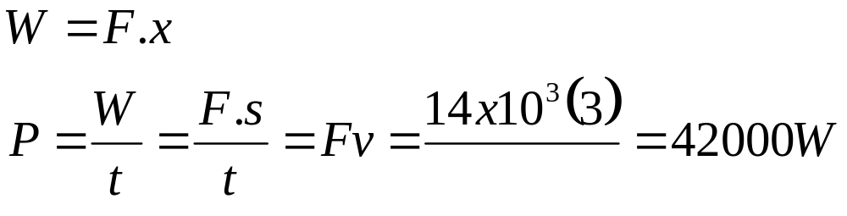
Example B- Tractor power
A certain tractor is said to be capable of pulling with a steady force of 14 kN while moving at a speed of 3.0 m/s. How much power in kilowatts is the tractor developing under these conditions ?

Slide 13
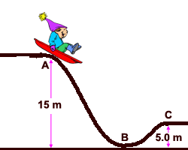
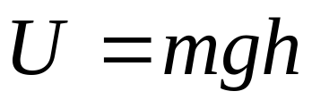
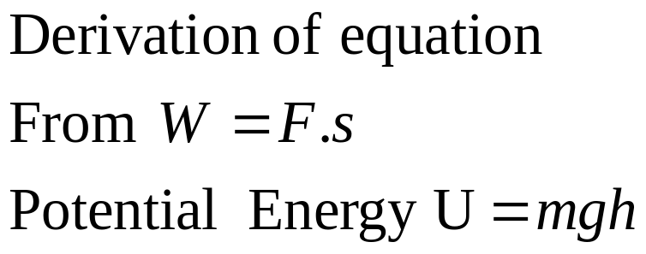
Gravitational potential energy
Gravitational potential energy is an energy associated with height and weight
Notes:
SO far we’ve talked about energy of motion, kinetic energy. But there are other types of energy.
One type we’ll talk about is an energy that can be stored and turns out to be related to position, positional energy.
What do I mean by that ? Well consider a man about to go bungy jumping. He’s up on a bridge, say 100 m above the ground. He’s going to jump off (or perhaps he gets pushed off) , starting with a velocity of zero m/s.
He could end up with a speed of 40 m/s ! That’s fast. Where did the kinetic energy come from to get him to accelerate so much ? It came from the fact that there is some stored energy in the system. When he got to the top of the bridge he had the potential to fall off and acquire kinetic energy. There was some stored energy or potential energy. If there is energy involved then there must be a force involved (energy = W = F times s). In this case the force is the force due to gravity, his weight. The higher the bridge, the greater his velocity at the end of the jump. So we have an energy associated with height and weight. We call it gravitational potential energy.

Slide 14
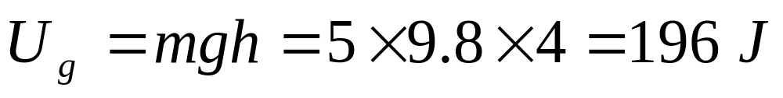
Potential Energy
A 5.0 kg box is lifted on top of the roof of a house 4.0 m high. Calculate how much potential energy it has gained.
Notes:
Let’s see if we can come up with an equation to describe this energy.
SEE SHEET FOR DERIVATION OF GRAVITATIONAL PE.
When the man goes up to the bridge he does work against the force of gravity, against his weight. This work is stored as gravitational potential energy. When he falls down off the bridge then his weight does work on him and this produces kinetic energy. The work done by gravitational force is positive but his potential energy decreases.
We use the same unit for gravitational potential energy as for kinetic, the joule, J.

Slide 15
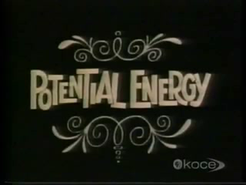

Slide 16
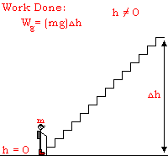

Slide 17
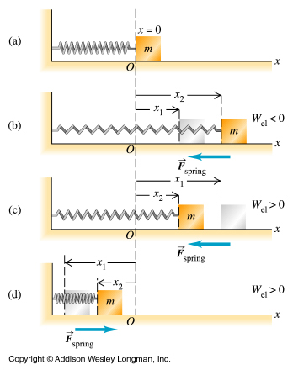
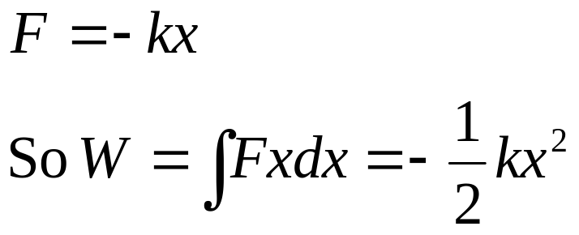
Elastic potential energy
Notes:
Another form of potential energy is elastic potential energy. Think of a rubber band. You pull it and stretch it in one direction, aim it at your friends back and then let go. It starts with zero velocity and ends up quite fast as it hits the target. You can think of bows and arrows if you’d rather, the principle is the same. How come we start with no ke and then end up with quite a bit ? Where does this energy come from ? We’re going to find that it is a similar case to the gravitational potential energy. Energy is stored due to a change in position (with gravity it was height changing). The change in position in this case is the change in extension of something elastic, like a spring. Something elastic is something that when stretched will go back to original size when the stretching force is taken away.

Slide 18
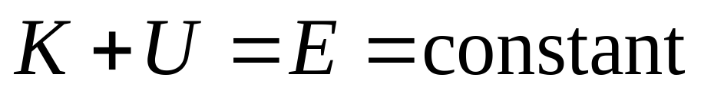
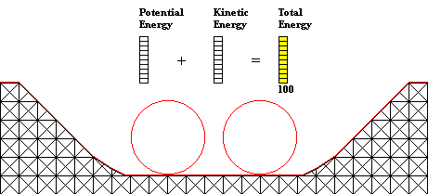
Conservation of mechanical energy
When only the force of gravity does work, the total mechanical energy is constant, it is conserved
Notes:
You can see from this that K+U is a constant. This constant is called the total mechanical energy of the system. When the only force doing work is gravity then the total mechanical energy is conserved. Known as the conservation of mechanical energy.

Slide 19
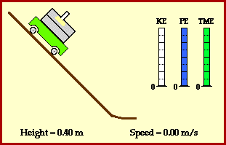
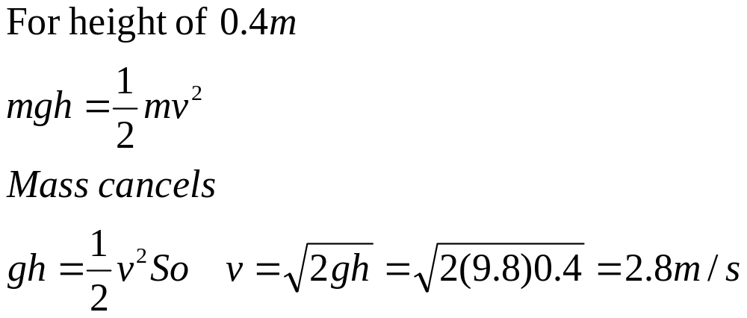
What is the final velocity, if the initial height is 0.4 m?
Notes:
Heres a jpeg to check… a weight on a cart falling a height of 0.4m…what velocity will it have when it reaches the bottom

Slide 20
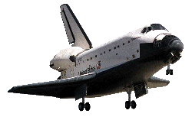
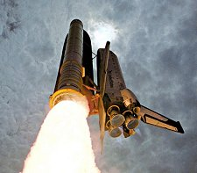
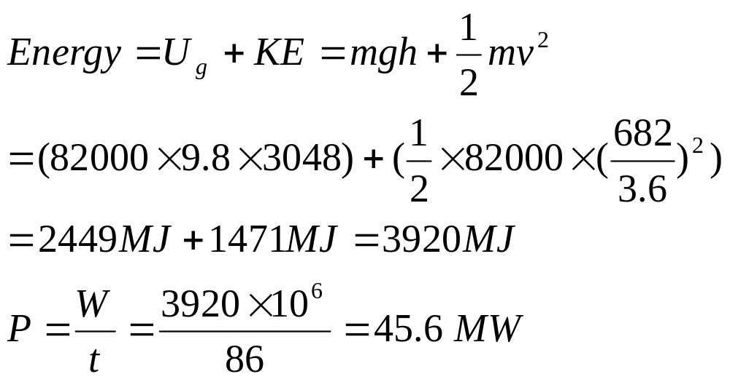
The space shuttle
At a point 86 seconds to touch down in the 82 ton orbiter’s landing sequence is as follows: It is moving at 682 km/hour at a height of 3048 m What is it’s average rate of power of dissipation from this point to landing?
Notes:
All appliances have an electrical properties panel…. A lot are sold by their power… vacuum cleaners… heaters… lights….

Slide 21
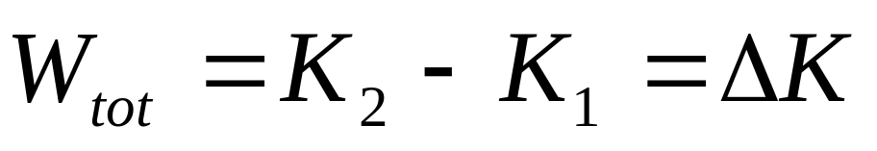
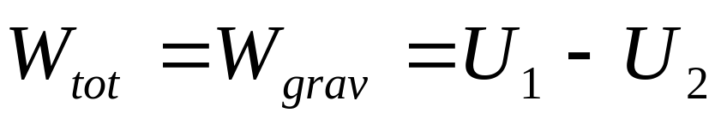
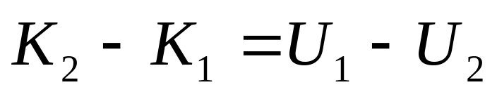
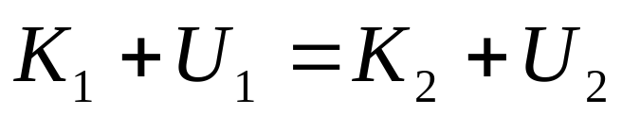
Conservation of mechanical energy
Work energy theorem states
Do work on something and it gains KE
Work done by gravity
If gravity does work on something it loses potential energy
Put together and get
Notes:
In order to use what we’ve learnt about kinetic and potential energy to solve complex problems we need to learn one more thing. The conservation of mechanical energy. Suppose we have a body falling freely with no air resistance. We know from the work energy theorem that the total work done on the body equals its change in kinetic energy. Wtot=K2-K1=delta K. If gravity is the only force that acts Wtot=Wgrav (gravity is the only force doing the work), so Wtot=Wgrav=-delta U = U1-U2. Putting these two together we get K2-K1=U1-U2. This gives K1+U1=K2+U2.

Slide 22
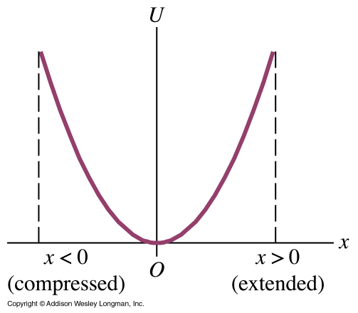
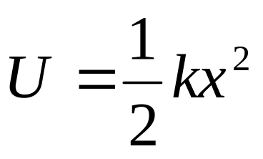
Elastic potential energy and work done by a spring
Elastic potential energy
Notes:
Lets graph the potential energy of a spring…. What is the y intercept….. Parabolic shape - 2nd order.. .
As the spring is stretched.. Or compressed it contains more energy.
What about the work done by the spring ? It’ similar to the case where we looked at work done in a gravitational field. There we had U=mgy. Here we have U=1/2 kx². We call this elastic potential energy. This is a graph showing how it changes according to extension. When extended, x is positive and x squared is +ve so U is +ve. When the spring is compressed then x is –ve but x squared is not so the energy is still +ve. How does the work and energy relate ? Similarly to the case for gravitational effects….we had W_{grav} = -delta U, now we have W_{el} = -delta U. When

Slide 23
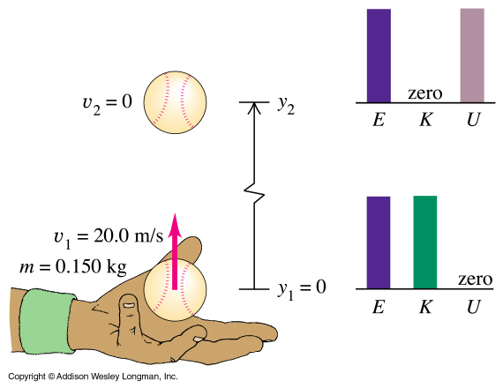
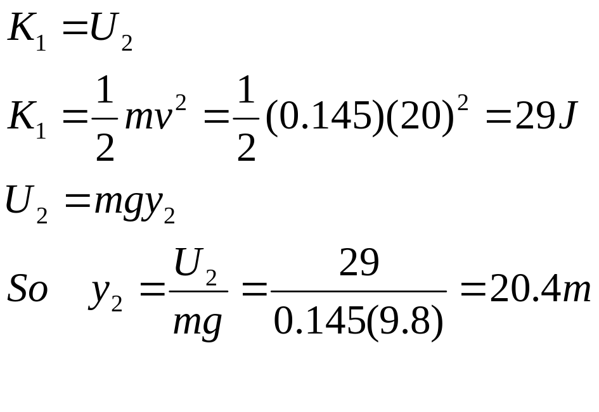
Example 7.1 Conservation of mechanical energy
Use conservation of energy to find how high the ball rises.
Notes:
Let’s do an example. Example 3

Slide 24
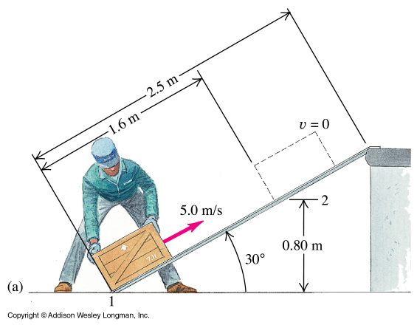


Example 7.6 Inclined plane
A crate is pushed with an initial velocity of 5.0 m/s up the ramp. The crate makes it to 1.6 m up the slope, stops and falls back down. Find the magnitude of the friction force.
Mass of crate = 12 kg
Ramp inclined at 30⁰
Notes:
That was with just gravity. What happens when we have other forces, including the elastic force, do work too ?

Slide 25


Example 7.9 Elevator- The cables of a 2,000 kg elevator break and it falls to the ground.
When it hits the cushioning spring it has a velocity of 4 m/s. The spring stops the elevator, compressing 2.00 m as it does so. A safety clamp applies a constant frictional force of 17,000 N to the elevator during the fall. What force constant is required for the spring to manage this ?
Notes:
SEE SHEET.
Example 5

Slide 26

Example 7.11 Elevator (cont)

Slide 27
Conservative and nonconservative forces
A conservative force is one where two-way conversion between kinetic and potential energies is possible eg ball being thrown up KE-PE-KE
A nonconservative force is one where two-way conversion between kinetic and potential energies is not possible. eg A cart slides up a ramp with friction- energy is lost.
Notes:
A conservative force is one where two-way conversion between kinetic and potential energies is possible.eg when throw a ball into the air, kinetic energy is changed to gravitational potential energy.Then it falls back and, if no air resistance, then gpe is converted back into kinetic energy. Final ke = initial ke.
A nonconservative force is one where the two-way conversion between kinetic and potential energies is not possible. Eg when a body slides up a slope, some of the kinetic energy goes to overcome friction so not all converted to gpe. When comes down the slope then again energy is required to overcome friction and so not all the gpe is converted back to kinetic energy. So final ke doesn’t equal initial ke.

Slide 28


